Slide 1

The happiness report
Human been known or seek what makes them happy. Power, Money, maybe being loved might make some happier than others. Maybe social security, political situation, could affect happiness feeling. So, is there any data to back these claims? The Happiness report could help us to develop some answers for these question

Slide 2
Research Question
What can governments and society improve to get a happier population?
To respond the question before, is necessary to ask to the data set:
What factors are the ones who significantly affect the most the happiness index in the world?
Which of these factors are affecting negatively and which ones positively?
What Continent is happier?

Slide 3
Definition of the Variables
"GDP" : in purchasing power parity (PPP) at constant 2011 international dollar prices are from the November 28, 2019 update of the World Development Indicators (WDI)
"Family“: (or having someone to count on in times of trouble) is the national average of the binary responses (either 0 or 1) to the GWP question “If you were in trouble, do you have relatives or friends you can count on to help you whenever you need them, or not?”
"Life.exp“: Healthy life expectancies at birth are based on the data extracted from the World Health Organization’s (WHO) Global
"Freedom“: to make life choices is the national average of responses to the GWP question “Are you satisfied or dissatisfied with your freedom to choose what you do with your life?”
"Generosity“: is the residual of regressing national average of response to the GWP question “Have you donated money to a charity in the past month?” on GDP per capita
"Corruption“: The measure is the national average of the survey responses to two questions in the GWP: “Is corruption widespread throughout the government or not” and “Is corruption widespread within businesses or not?” The overall perception is just the average of the two 0-or-1 responses. In case the perception of government corruption is missing, we use the perception of business corruption as the overall perception. The corruption perception at the national level is just the average response of the overall perception at the individual level.
“Happiness Score”: subjective well-being (variable name ladder ): The survey measure of SWB is from the Feb 28, 2020 release of the Gallup World Poll (GWP) covering years from 2005 to 2019. Unless stated otherwise, it is the national average response to the question of life evaluations. The English wording of the question is “Please imagine a ladder, with steps numbered from 0 at the bottom to 10 at the top.
"Country”: where the study was made
Happiness Rank will be used as based number to place the countries in the analysis
This variables (1-7) are the factors that the Happiness Report uses to calculate the Happiness score, in other words, these are the variables affecting the happiness score in the report, and placed the country in its corresponding Happiness Rank. Each value corresponds to the extent in which that variable contributes to the calculation of the Happiness Score
Helliwell. J, Huang. H, Wang. S, and Norton. M. (2020). Statistical Appendix for Chapter 2 of World Happiness Report 2020

Slide 4
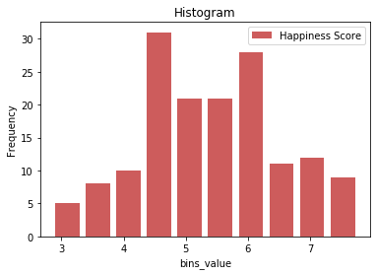
Histogram of Happiness Score
Happiness Score: Is a distribution that present 2 modes and has a more normal look. It does not present any visible outlier. Most of the countries have a Hapiness Score between 4.5 and 6
Mean 5.407096
Variance 1.239036
Std 1.11312
Max 7.769
Min 2.853
Mode 0 5.208
Tail
151 3.334
152 3.231
153 3.203
154 3.083
155 2.853

Slide 5
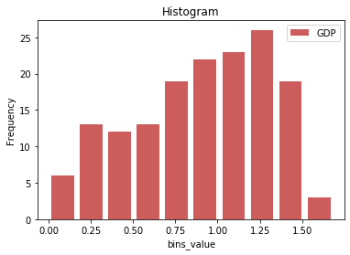
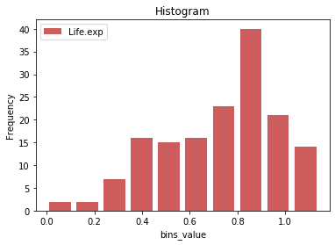
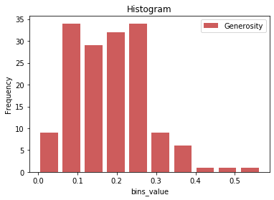
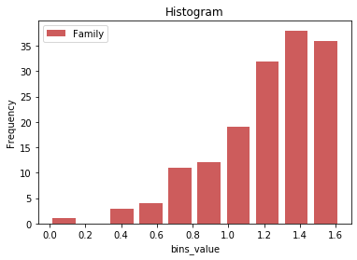
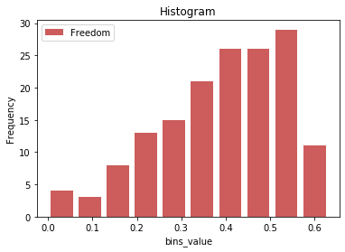
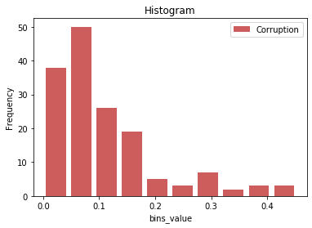
Histogram
GDP
Life. exp
Generosity
GDP: Distribution looks more uniform than Normal, It has a small skewness to the left. is not easy to identify any outlier. Values if this variable grater than 1.5 are less often to see the all the values smaller than 1.5
Life. exp: This distribution looks skewed to the left as well, but with not outliers easy to identify
Generosity: Distribution skewed to the right, with possible outliers laying in the bins with values greater than 0.4. All values are going to be included in the analysis
Family
Freedom
Corruption
Family: Distribution skewed to the left, with possible outliers included in the bin of values between 0 and 0.2. All the values are going to be included. Values NA are going to be dropped
Freedom: Distribution does not present any form or any outliers easy to identify
Corruption: Distribution skewed to the right, no outliers easy to identify.
All possible outliers identified in the analysis above are going to be included, because the perception of the factors for a specific country affect the Happiness Score of the world, to determine what makes us happy based on the analysis of this data, is necessary to include the score of every country. Even than some countries can be considered “outliers” because a specific political, economical or social situation, this is not the goal of the study, but it is to determine what factors are scientifically related with the happiness score

Slide 6
Variable’s Description
GPD
Mean 0.905147
Variance 0.158714
Std Dev 0.398389
Mode 0 0.96
Tail
151 0.359
152 0.476
153 0.350
154 0.026
155 0.306
Life.exp
Mean 0.725244
Variance 0.058624
Std Dev 0.242124
Mode 0 0.815
1 0.999
Tail
151 0.614
152 0.499
153 0.361
154 0.105
155 0.295
Generosity
Mean 0.184846
Variance 0.009073
Std Dev 0.095254
Mode 0 0.153
Tail
151 0.217
152 0.276
153 0.158
154 0.235
155 0.202
Corruption
Mean 0.110603
Variance 0.008937
Std Dev 0.094538
Mode 0 0.028
1 0.078
2 0.089
Tail
151 0.411
152 0.147
153 0.025
154 0.035
155 0.091
Family
Mean 1.208814
Variance 0.089515
Std Dev 0.299191
Mode 0 1.465
Tail
151 0.711
152 0.885
153 0.517
154 0.000
155 0.575
Freedom
Mean 0.392571
Variance 0.020532
Std Dev 0.143289
Mode 0 0.498
1 0.509
2 0.557
Tail
151 0.555
152 0.417
153 0.000
154 0.225
155 0.010

Slide 7
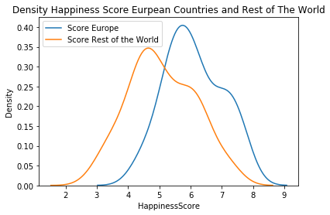
Forbes (2018) state Europe as the happiest continent in the world. What does happen if we analyze Happiness Score in Europe and compare it with the Happiness score of the rest of the world?
Density Analysis
From this plot, European countries actually has a better happiness score than the rest of the world, they have less variance in its data and a higher median, taking out the European country from the total result (All the countries) makes the curve of the happiness score of the rest of the countries moved is median to the right, where the lower scores are

Slide 8
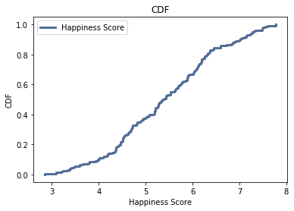
CDF for Happiness Score
The countries that has reported lower Happiness Score are the ones that has a score of less 4.2 (Information from the Histogram), from the CDF plot, approximately less than 15% of the 156 countries that participate in the survey report this low numbers.
The 50% of the countries report approximately 5.5 Happiness Score, the Maximum Happiness Score was 7.769, so it could be said that the world half of the Happy in the Happiness Score range

Slide 9
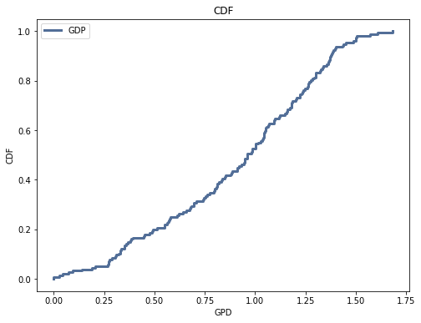
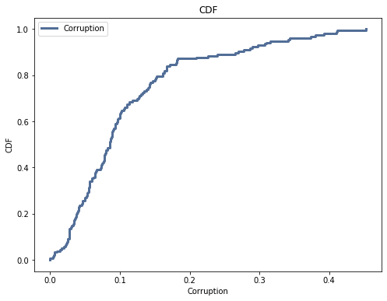
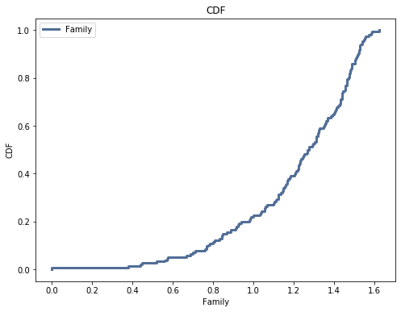
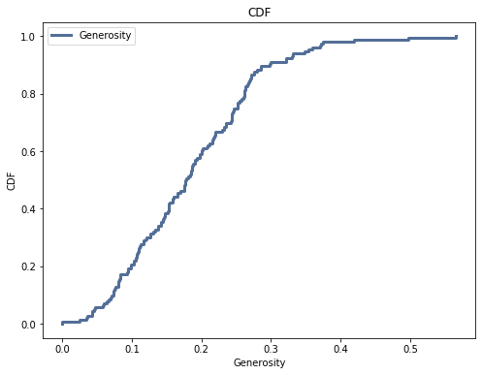
CDF
In 50% of the countries the trust in the Government contributes with only 0.1 to the Happiness Score calculation. What this number means, is that the Government does not have to work so hard in the trust of their people to make them happy
In 75% of the countries the GDP contributes in 1.2 to the Happiness Score calculation. What is significantly a high contribution to the happiness score
In 75% of the countries Family contributes in 1.2 to the Happiness Score calculation
Almost every country shows that the Generosity, or some relation with the society it only contributes with in 0.8 to the Happiness Score calculation. So looks like relation with the neighbor is not that important either to make us happy

Slide 10
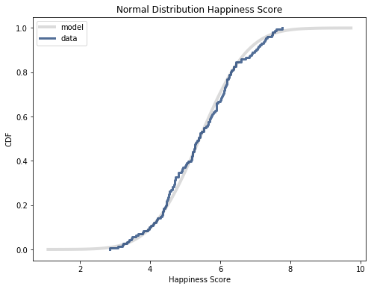
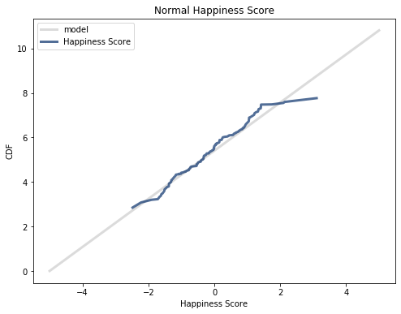
CDF of Normal Distribution for Happiness Score
The Probability Plot indicates that low scores and the higher ones seems to be off the normal. Inside the code there is an option to plot the log normal, and from that analysis the distribution looks more normal than lognormal

Slide 11
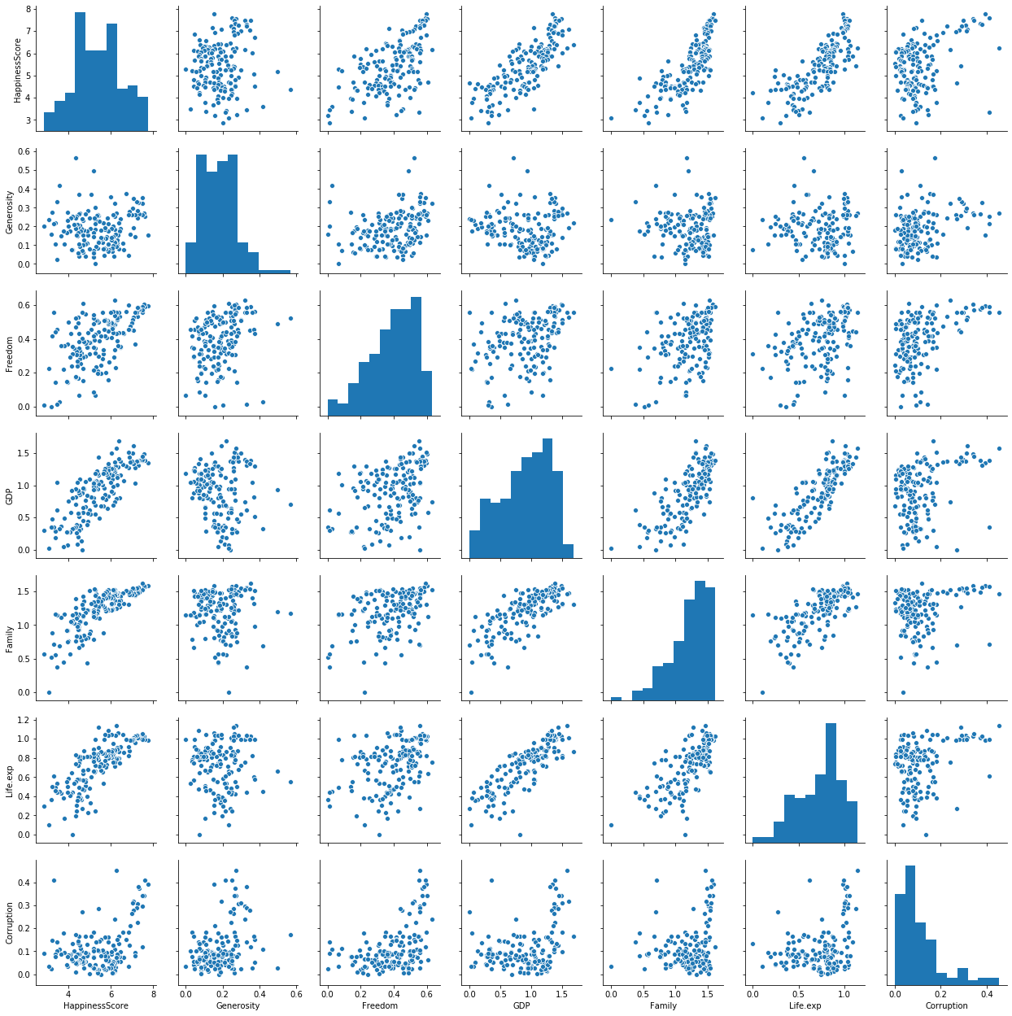
Scatter Plot For all variables
Almost all variables present not linear relationship with Happiness Score. However, the analysis is going to be done in depth to those ones that present higher correlation

Slide 12
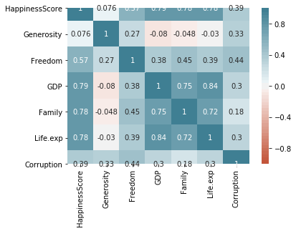
Correlation Heatmap
Blue means positive, red means negative. The stronger the color, the larger the correlation magnitude
Almost all variables present a positive correlation with Happiness Score. Focused on the Research Question, it can be used for deep analysis:
GDP Correlation=0.84
Life.exp Correlation=0.84
Family Correlation = 0.78

Slide 13
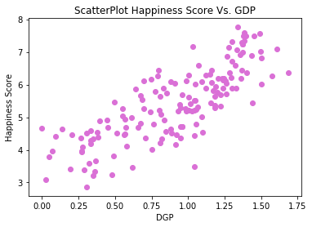
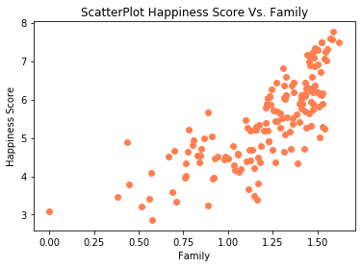
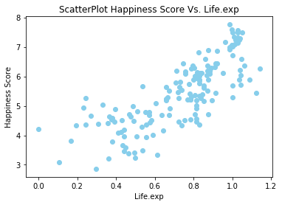
Scatter Plot Happiness Score Vs variables with higher Pearson’s Correlation
From the detailed scatterplot of the variables with higher Pearson’s correlation, the relationship in the charts are not exactly linear, specially the Life.exp and Family with Happiness Score. To extend the analysis Spearman’s correlation for the 3 variables:
Spearman Correlation Happiness Score-Life.exp: 0.8161807357057258
Spearman Correlation Happiness Score-Family: 0.8072745738421484
Spearman Correlation Happiness Score-GDP: 0.8144834033942764
The 3 values of correlation are above 0.7, family-Happiness Score was the value that present higher Spearman than Pearson, following analysis will be continued been made with these 3 variables
From the Correlation Chart, Corruption or trust in the government present a non-linear shape, calculating Spearman’s for this variables:
Spearman Correlation Happiness Score-Corruption: 0.2173484222491679
The correlation increases from 0.39 to 0.217. This variables is going to be included in the regression analysis because is a key for governments and their direct contribution with the happiness of the population

Slide 14
Are the Correlation of the Variables in study statistically significant?
pvalue of Correlation test Family-Happiness Score 0.0
pvalue of Correlation test GDP-Happiness Score 0.0
pvalue of Correlation Life.exp-Happiness Score 0.0
pvalue of Correlation test Corruption-Happiness Score 0.0
As expected, all the variables are statistically significant correlated with the Happiness Score, this is because this values are used to calculate the score
Is the mean of the Happiness Score of European countries statistically significant than the mean of the Score in the rest of the countries of the world?
pvalue Difference in mean of Happiness Score in European Countries and rest of the Countries 0.0
Pvalue for this test is 0.0, indicating that there is a statistically difference between the mean of the Happiness Score of European Countries and the rest of the world, so, they are happier
Pvalue less than 7%: reject null hypothesis

Slide 15
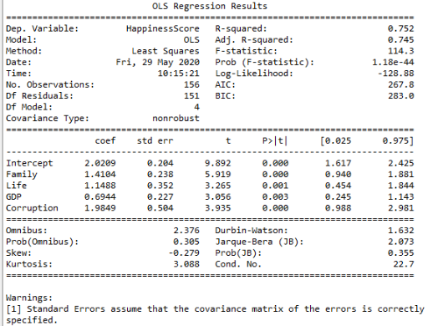
Regression Analysis
All 4 variable sin study are statistically(pvalues < 0.07) significant and the R2 value is 0.752 so the variables account for a substantial part of the variation of the Happiness Score.
All variables contributes in a positive way to the Happiness Score, indicating that the perception of the participants on the study about the variables will affect to the final score.
Interesting than Corruption that present smaller correlation, has a slope of 1.99 (the higher) in the regression, what indicates that a variation in the government performance do affect the happiness of the population in a good proportion

Slide 16
Conclusion
Perception of happiness is sometime very personal, but having a common perception is also not wrong, governments make a big impact in the happiness of their people with its management of the economy and the measurements that they take. Also is important to highlight the fact than having a family time and be able to make and have a family is a big part of the wellbeing of the society. Governments can address efforts to help their people happiness giving attention to the trust that they generate and with proper manage of the economy, even than governments don’t have a direct effect on personal family matters, to have policies about labor and social policies will help society to develop better quality time with their beloved ones

